Slide 1
TapToBook data analysis
Bookings, campaigns, and discounts

Slide 2
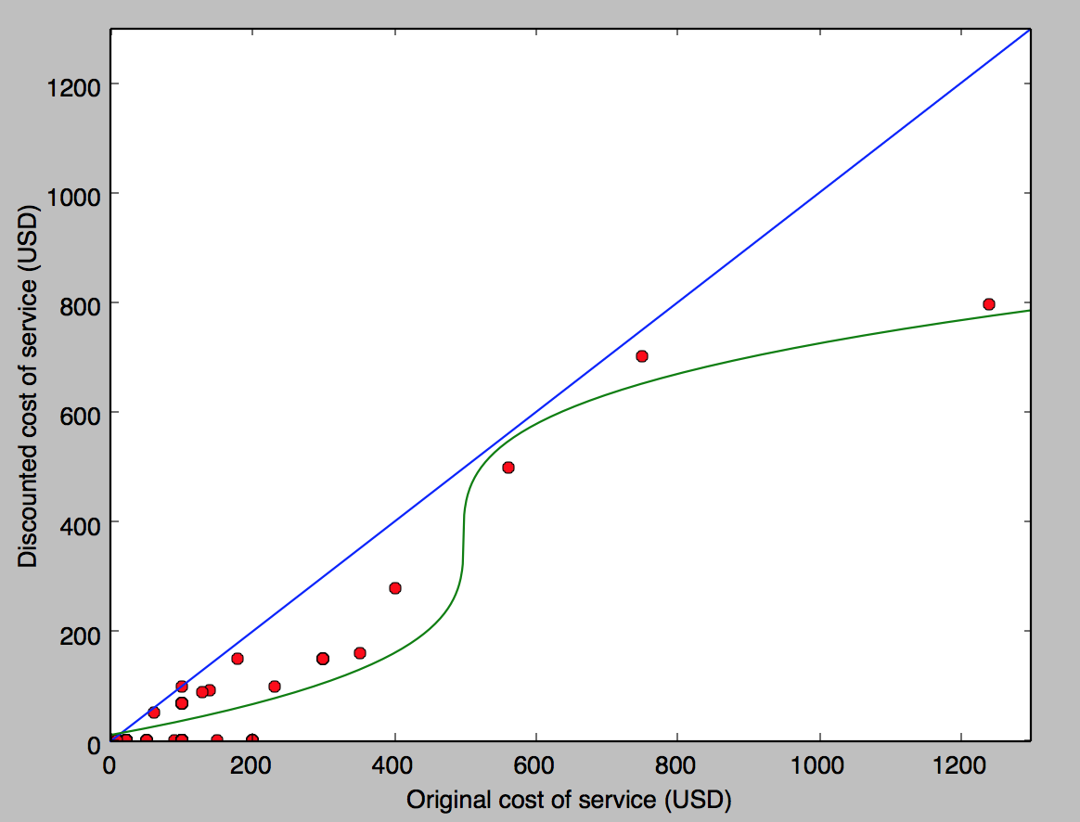
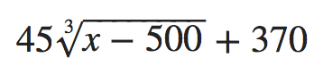
Discounts
Blue line for equal price
Green line of best fit
Massage LuXe Coral Springs—99$ both
Equation for line of best fit

Slide 3
discounts

Slide 4
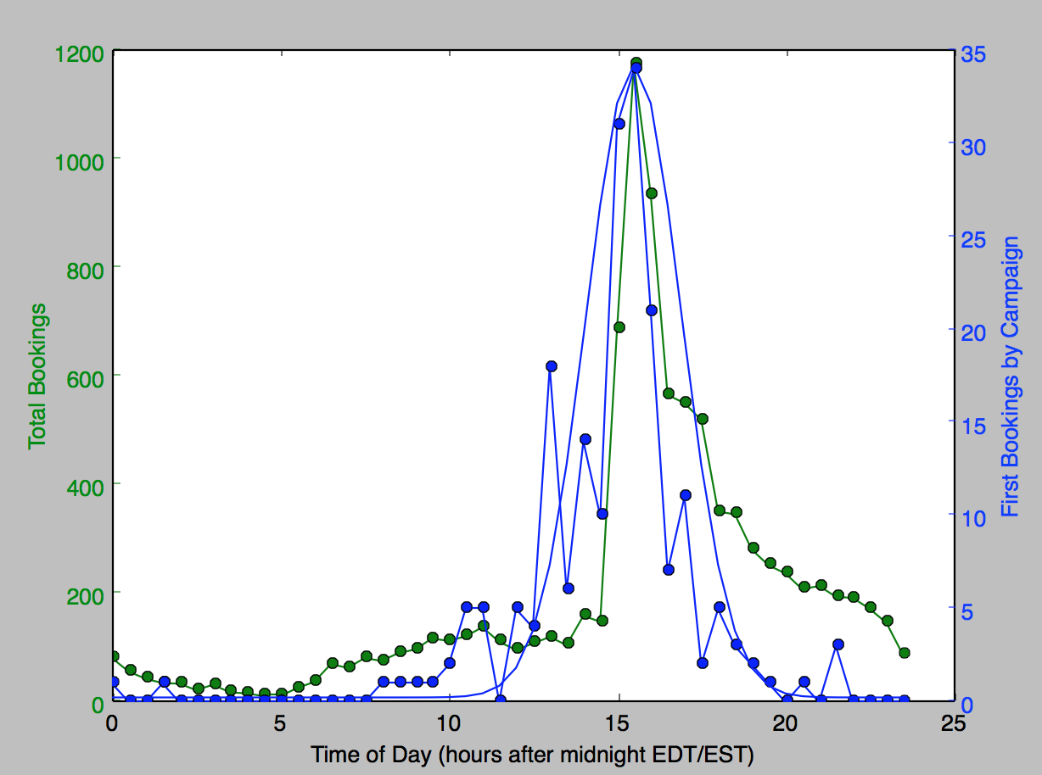
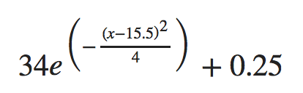
Total vs first bookings
Adjusted time zone for EST and EDT
Found spike at around 15:00
Line of best fit

Slide 5
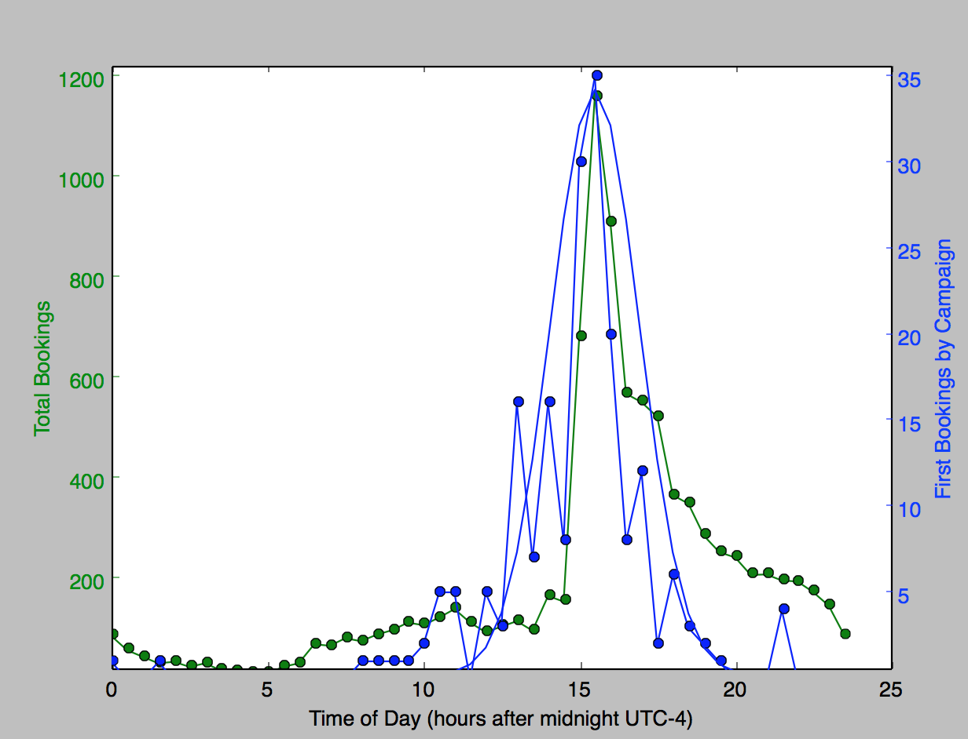
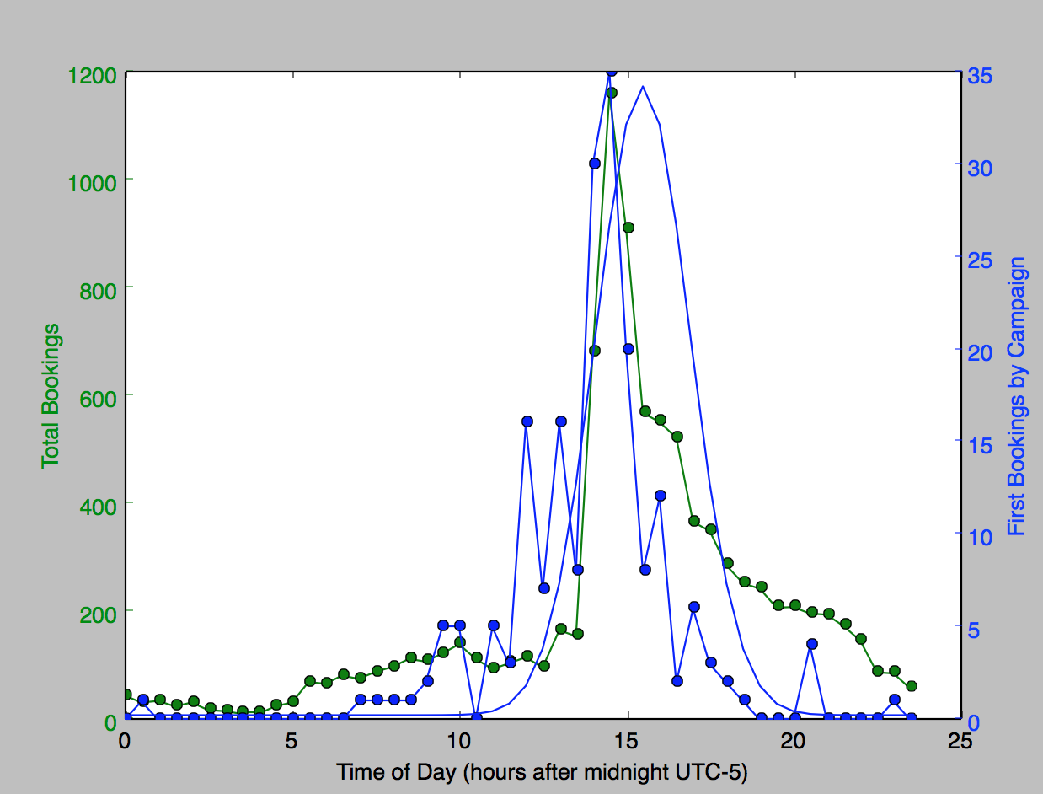
EDT vs EST data
Line of best fit works for EDT
Doesn’t work for EST
More in the spring and summer?

Slide 6
EDT vs EST data

Slide 7
Incomplete data
Possibility?

Slide 8
Incomplete data
Earliest booking in February 2018
Most recent booking 2 July 2018
Incomplete data explains time zone problem

